Slide 1
JUnit Testing

Slide 2
Unit Tests
A unit test tests a single method or perhaps a small group of related methods, or a single class.
Methods and classes are tested in isolation, rather than as a single large program.
Notes:
Big Java, 2nd edition, Chapter 10

Slide 3
Test Harnesses
A test harness is a class that has only one purpose: to test methods or another class.
A test harness supplies parameters to the class or methods being tested.

Slide 4
Example
Lets use our example from before but assign grade values to the ranges.
Value below 0 = “Error”
Value between 0 and 60 = “F”
Value between 60 and 69 = “D”
Value between 70 and 79 = “C”
Value between 80 and 89 = “B”
Value over 89 = “A”

Slide 5
Example
Lets use our example from before but assign grade values to the ranges. So now we can come up with test cases:
-1 is “Error”,
0 is “F”, 25 is “F”, 59 is “F”
60 is “D”, 63 is “D”, 69 is “D”
70 is “C”, 73 is “C”, 79 is “C”
80 is “B”, 86 is “B”, 89 is “B”
90 is “A”, 91 is “A”, 99 is “A”,
100 is “A”, 2000 is “A”

Slide 6
Example
We write a class named GradeScheme containing a single static method named getGrade, shown on the next slide.

Slide 7
Example
public static String getGrade(int score)
{
if(score < 70) {
return ”D";
} else if(score < 80) {
return ”C";
} else {
return ”A";
}
}

Slide 8
Writing Test Classes
For small classes, with only a few methods, we can easily create specialized classes (test harness) that tests the methods in our class.
Usually you would want to have a file that contains test values and expected result.

Slide 9
Writing Test Classes
But for large projects with hundreds of methods, writing classes to enable repeatable testing can be a difficult and time-consuming task – but it is even more important in such situations.

Slide 10
JUnit Testing
JUnit is a framework for writing repeatable tests.
It was designed for Java but has been ported to include PHP, C#, Python, and Perl.
This family of unit test frameworks is referred to as xUnit.
Notes:
http://junit.sourceforge.net/ and http://en.wikipedia.org/wiki/JUnit

Slide 11
JUnit Testing in NetBeans
NetBeans provides full support for JUnit versions 3 and 4.
We will use JUnit 4 inside NetBeans.
Suppose we have a class GradeScheme defined as shown on the next page.

Slide 12
Class GradeScheme
public class GradeScheme {
public static String getGrade(int score)
{
if(score <= 70) {
return ”D";
} else if(score < 80) {
return ”C";
} else {
return ”A";
}
}
}

Slide 13
Creating the Test Class
After creating class GradeScheme, right-click the name of the class in the Projects window and choose Tools, Create/ Update Tests.
Select Junit as the framework.

Slide 14
Creating the Test Class
The test class is named with the same name as the original class, followed by Test.
The package name should be the same as for the original class and will be under the Test Packages directory.

Slide 15
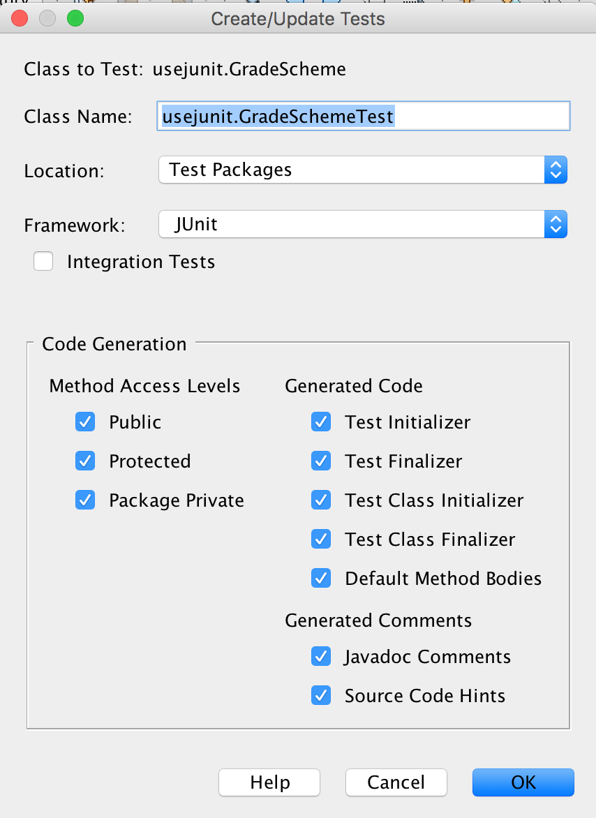
Create Tests Window
JUnit create
GradeScheme was in usejunit package so it is prepended to the name
Location of file is in Test Packages

Slide 16
GradeSchemeTest.java
The test class (GradeSchemeTest.java) opens in the source editor.
The code is shown on the next several slides.

Slide 17
GradeSchemeTest.java
import statements
import org.junit.After;
import org.junit.AfterClass;
import org.junit.Before;
import org.junit.BeforeClass;
import org.junit.Test;
import static org.junit.Assert.*;

Slide 18
GradeSchemeTest.java
public class GradeSchemeTest
{
public GradeSchemeTest ()
{
}
This constructor does nothing except to create an object.
Recall that, for any class, if no constructor is provided Java provides a no-arg constructor equivalent to the above.

Slide 19
GradeSchemeTest.java
@BeforeClass
public static void setUpClass(){
}
@AfterClass
public static void tearDownClass(){
}
Use these methods for any code that you want to run exactly once, either before or after the test cases are run.

Slide 20
GradeSchemeTest.java
@Before
public void setUp(){
}
@After
public void tearDown(){
}
Use these methods to provide any common code used by all the method tests.
setUp is called before each method test
tearDown is called after each method test

Slide 21
GradeSchemeTest.java
In addition to setUp and tearDown, methods for testing each method in the original class will be created.
The name of each method will be the same as the method being tested, except that the name will start with a capital letter and be preceded by the word test (this is not required but is suggested)

Slide 22
GradeSchemeTest.java
@Test
public void testGetGrade() {
System.out.println("getGrade");
int score = 0;
String expResult = "";
String result = GradeScheme.getGrade(score);
assertEquals(expResult, result);
// TODO review the generated test code and remove the default call to fail.
fail("The test case is a prototype.");
}
The fail case is included to ensure that you have reviewed the code and made any necessary changes; it should be removed before running

Slide 23
Modifying GradeSchemeTest
Modifications include
Common code may be pulled out of the individual test methods and placed in setUp or tearDown; However, there is only one method to test, so we will leave all code in testGetGrade.
origVal and expResult will be changed to reflect a test value and the result we expect.
The fail statement will be removed.

Slide 24
Revised GradeSchemeTest
@Test
public void testGetGrade() {
System.out.println("getGrade");
int score = 60;
String expResult = "D";
String result =
GradeScheme.getGrade(score);
assertEquals(expResult, result);
}

Slide 25
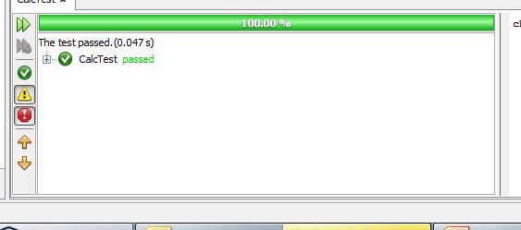
Running GradeSchemeTest
Right-click on GradeSchemeTest.java and choose Run File; output is shown below

Slide 26
A Failed Test
Lets add in some more data values. We are going to test the low end for each return value. (We also change the name of the test.)
@Test
public void testGetGradeLowest() {
System.out.println("getGrade lowest");
assertEquals("A", GradeScheme.getGrade(90));
assertEquals("B", GradeScheme.getGrade(80));
assertEquals("C", GradeScheme.getGrade(70));
assertEquals("D", GradeScheme.getGrade(60));
assertEquals("F", GradeScheme.getGrade(0));
}

Slide 27
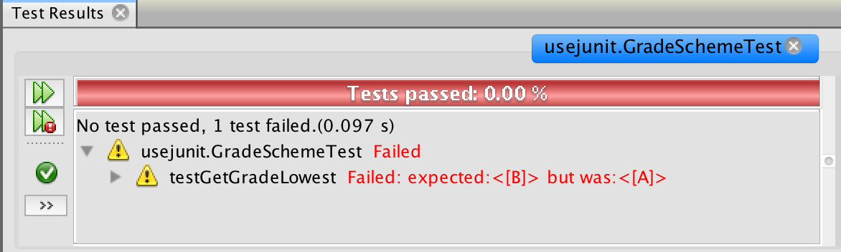
A Failed Test
Then our JUnit test will fail (as it should) and we get the output shown below.

Slide 28
A Failed Test
Lets add in more test. We will test for the highest value and middle values in each range. We will test values outside of the 0 to 100 range.
@Test
public void testGetGradeMiddle() {
System.out.println("getGrade middle range");
assertEquals("A", GradeScheme.getGrade(94));
assertEquals("B", GradeScheme.getGrade(85));
assertEquals("C", GradeScheme.getGrade(75));
assertEquals("D", GradeScheme.getGrade(64));
assertEquals("F", GradeScheme.getGrade(30));
}

Slide 29
A Failed Test
@Test
public void testGetGradeHighest() {
System.out.println("getGrade highest");
assertEquals("B", GradeScheme.getGrade(89));
assertEquals("C", GradeScheme.getGrade(79));
assertEquals("D", GradeScheme.getGrade(69));
assertEquals("F", GradeScheme.getGrade(59));
}
@Test
public void testGetGradeOutOfRange() {
System.out.println("getGrade out of range");
assertEquals("A", GradeScheme.getGrade(101));
assertEquals("A", GradeScheme.getGrade(150));
assertEquals("Error", GradeScheme.getGrade(-1));
assertEquals("Error", GradeScheme.getGrade(-100));
}

Slide 30
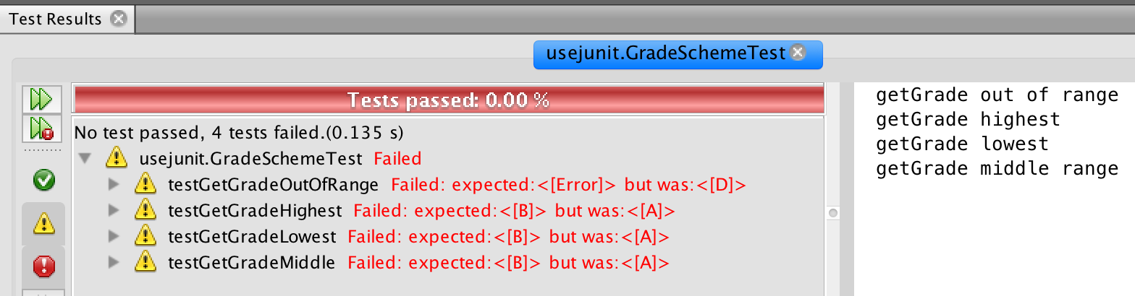
A Failed Test
Now when we run it, all four test cases fail.

Slide 31
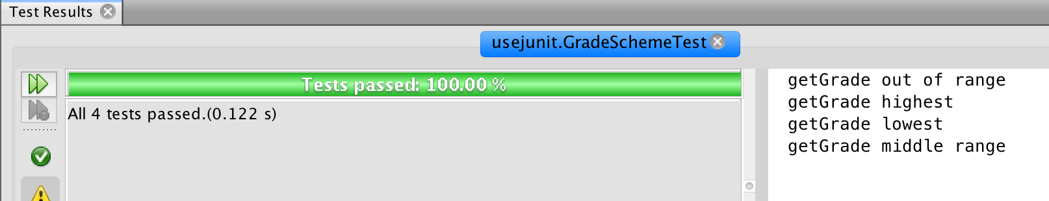
Code Revision
Now that we have test cases, we can work on making the code work. (Note: Sometimes the test case specification is wrong, so check both the code and the expected value.)
After fixing the code, we get a success.

Slide 32
More on Annotations
You can use the expected parameter with the @Test annotation if you are testing to see if an exception is thrown.
For example, suppose you write a method where you expect an ArithmeticException to be thrown
Use
@Test(expected = ArithmeticException.class)

Slide 33
More on Annotations
If you have a test case that you want to skip, you can use the @Ignore annotation
@Ignore("not ready for testing")
@Test
...
The string parameter is optional.
@Ignore requires an import (org.junit.Ignore)

Slide 34
JUnit Testing
The End

